Slide 1
Cargo hold coating performance analysis
Data and Performance Pictures
Victor wang
Oct. 2019

Slide 2
Background & Purpose
Evaluate the in-service performance of the Jotaguard Series and support the SAR &Marketing

Slide 3
Background
Ultra Premium
Jotaguard 600 Series
630,660,690,690S
Premium
Jotamastic Series
80,87,90
Strengthen the strengths
Qualified
Jotacote Universal
Jotaprime 500
Standard
Penguard FC
Primastic
Convince the customers to use the ultra premiums
Commercial
Others

Slide 4
Purpose
Internal factors
External factors
Product analysis
Marketing positioning
Sales focus
Customer preference
Voyager lines
Controllable
Start
R&D formula
Company strategy
Product application
Competitor product innovation
Industry cycle
Uncontrollable

Slide 5
数据挖掘和收集
0 2
Sup porting text here.
When you copy & paste, choose "keep text only" option.

Slide 6
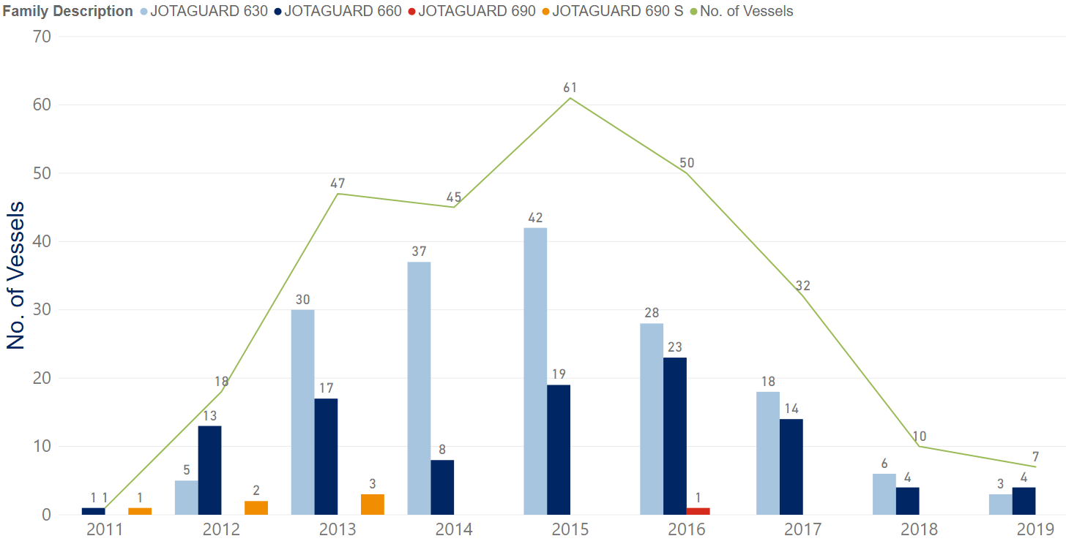
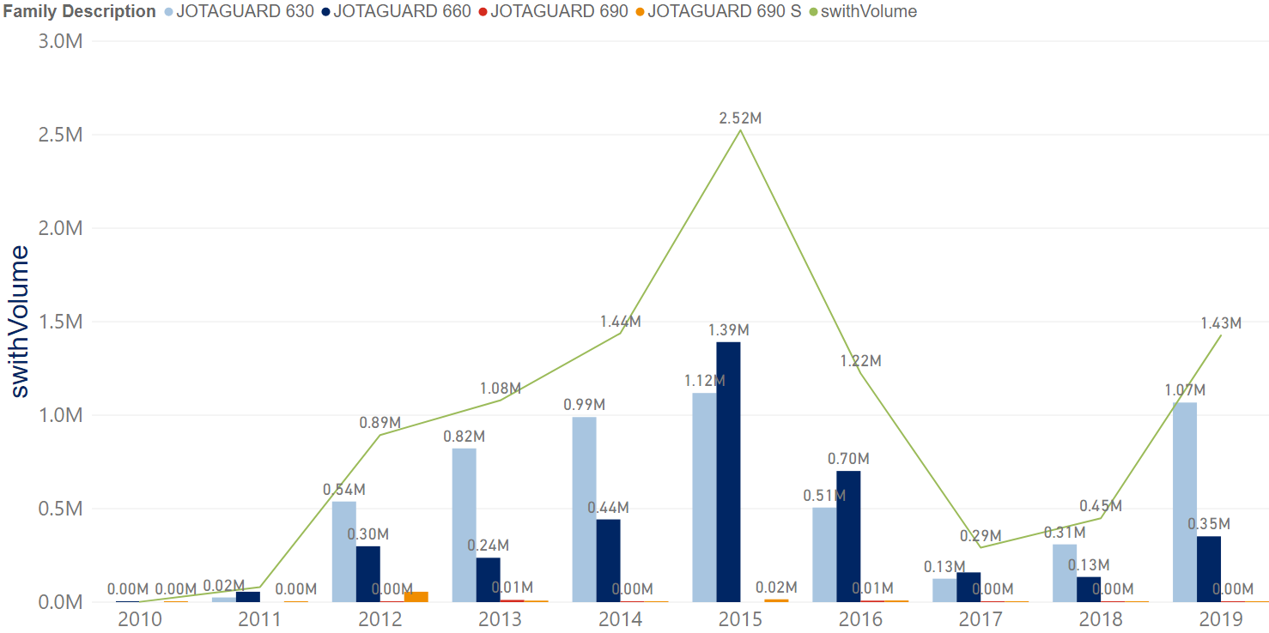
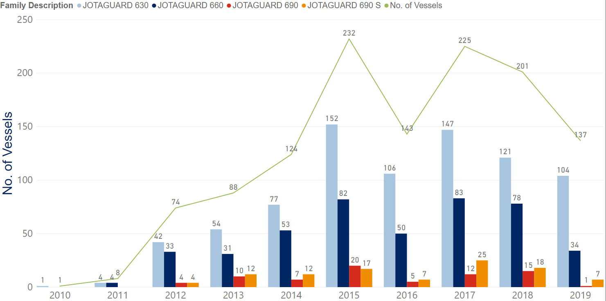
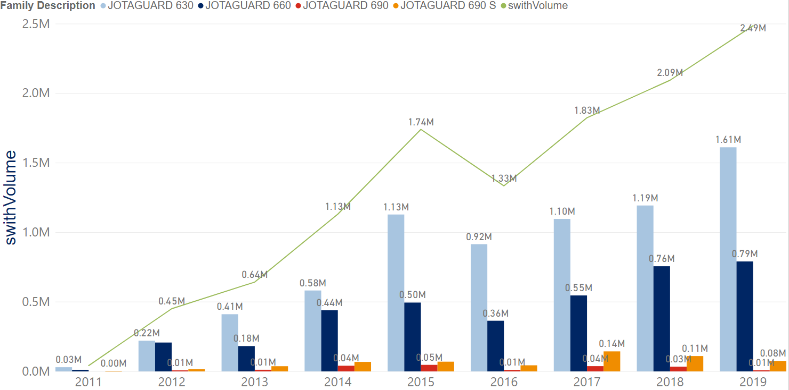
Product sales reference
Projects No.
Sales Volume
NB
DD
Main Focus
DD sales is increasing steadily while NB is decreasing generally.
The No. of projects decreasing with the volumes going up, it indicates single project is getting larger. More larger vessel size is using the Jotaguard series.

Slide 7
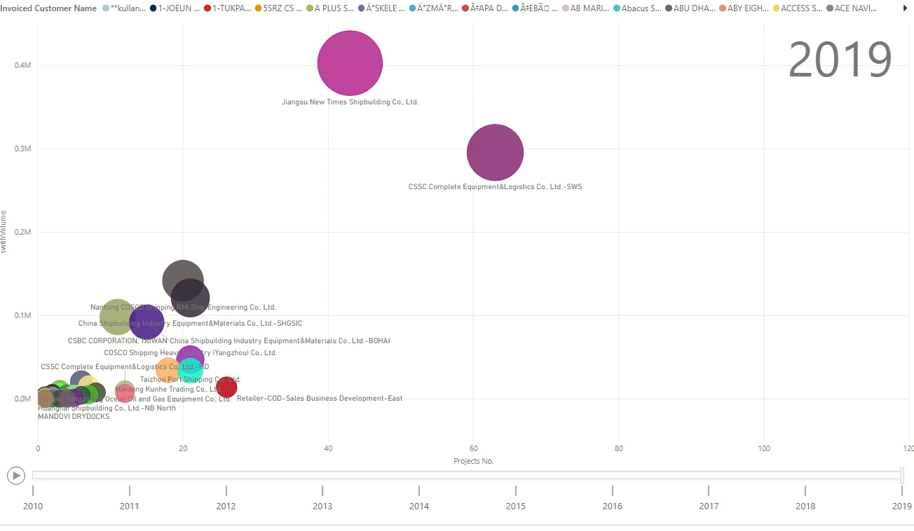
Customer Profile
NB
Notes:
点击图像可播放

Slide 8
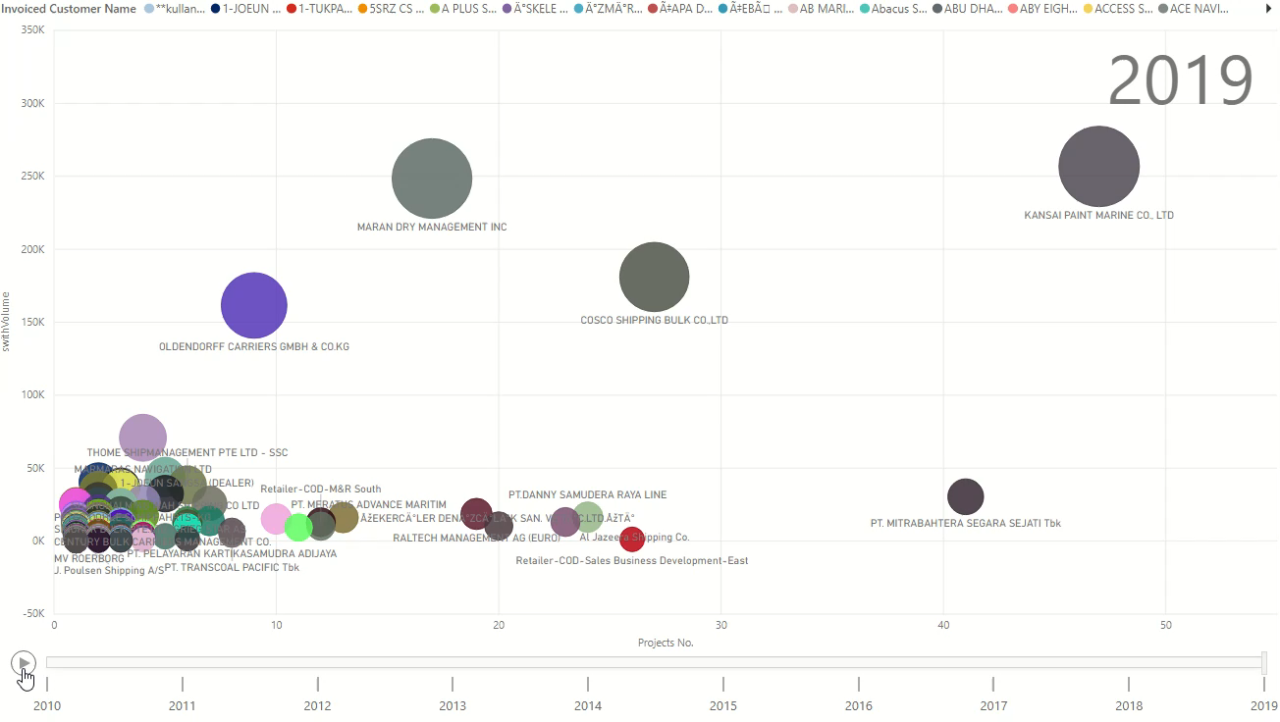
Customer Profile
DD
Notes:
点击图像可播放

Slide 9
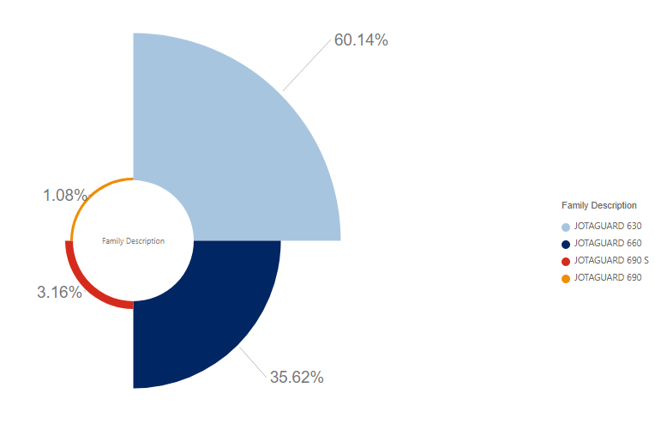

Top 10 Customer Preference(product composition)
61%
36%
Opportunity
3%
1%
JOTAGUARD 630
JOTAGUARD 660
JOTAGUARD 690
JOTAGUARD 690S
1. Jotaguard 630&660 is the main product used, maintain the volume and improve the volume of the more profitable 690&690s.

Slide 10
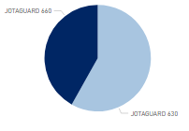
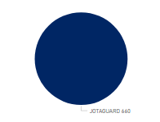
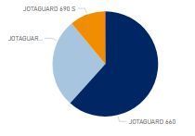
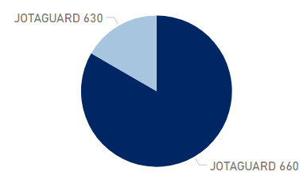
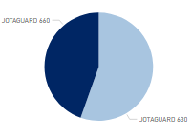
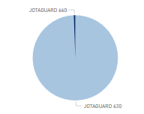
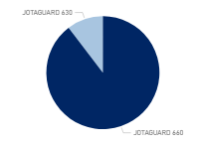
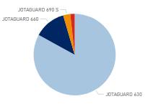
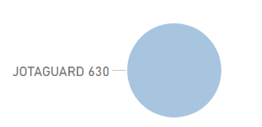
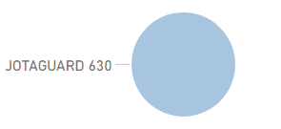
Top 10 Customer Preference
Invoiced Customer Name (top10) | Volume
Sinopacific Shipbuilding Group Co., Ltd. | 991305
CSSC Complete Equipment&Logistics Co., Ltd.-SWS | 808720
KANSAI PAINT MARINE CO., LTD | 740320
China National Shipbuilding Equipment&Materials (East China) Co., Ltd.-JN2# | 615160
Tianjin Xingang Shipbuilding Heavy Industry Co., Ltd. | 450080
Jiangsu New Times Shipbuilding Co., Ltd. | 431280
MARAN DRY MANAGEMENT INC | 421260
OLDENDORFF CARRIERS GMBH & CO.KG | 414660
COSCO Shipping Heavy Industry (Zhoushan) Co., Ltd.-NB East | 410160
COSCO Shipping Heavy Industry (Yangzhou) Co., Ltd. | 389632
1. Only KANSAI PAINT MARINE CO., LTD, OLDENDORFF CARRIERS GMBH & CO.KG
used Jotaguard 690&690s
2. In our research, the main customer to get the performance data is Kansai and oldendorff.

Slide 11
Analysis process
0 3

Slide 12
Process of performance analysis
调研和收集
数据清洗
建模分析
设计调研报告，收集收集数据
Python, Excel清理数据
运用统计模型以及市场分析模型分析数据
创建数据库
可视化报告
收集到的数据，公司内部销售数据存入Mysql
Power bi 可视化报告

Slide 13
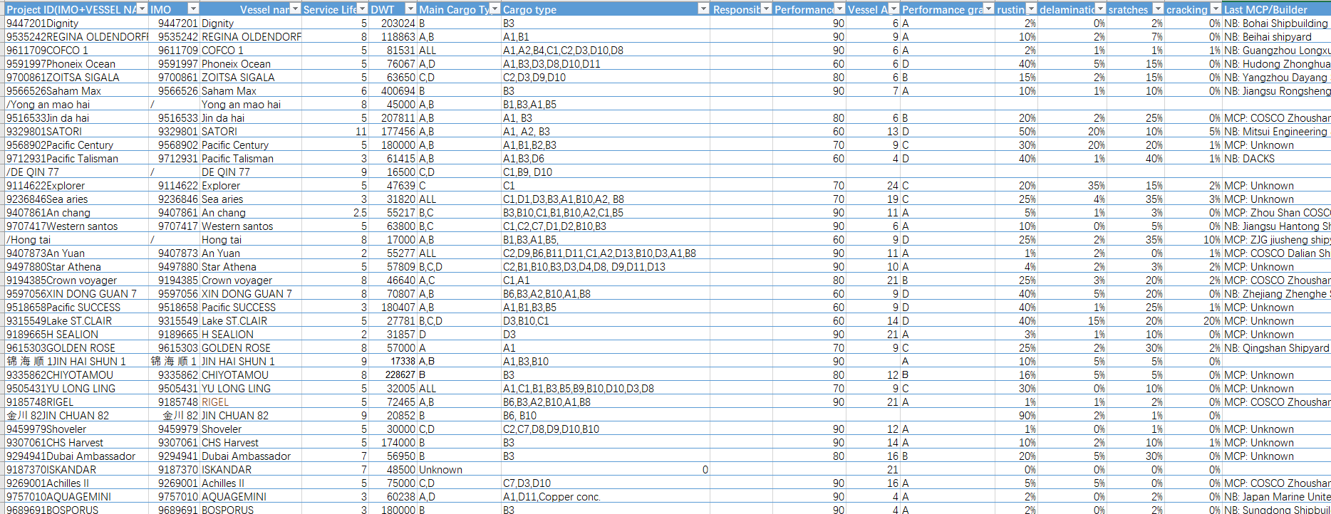
Collecting Performance Data

Slide 14
Rating schema
Anticorrosive property
Rusting
Flaking
Cracking
Rating the values with some standard
AS=100-(100*rusting+50*flaking+10*scratches+80*cracking)
Other factors
Scratches
Cargo type
Average voyages
Vessel size
Vessel age
Product type
Cleaning property
Cleaning time
Detergent liters
Cleaning fees
Rating the property with some standard
As discussed, the overweight of the anticorrosive should be 60%, the cleaning property should be 40%.
Total performance=60% AS+40% CS
Last cargo
People needed

Slide 15
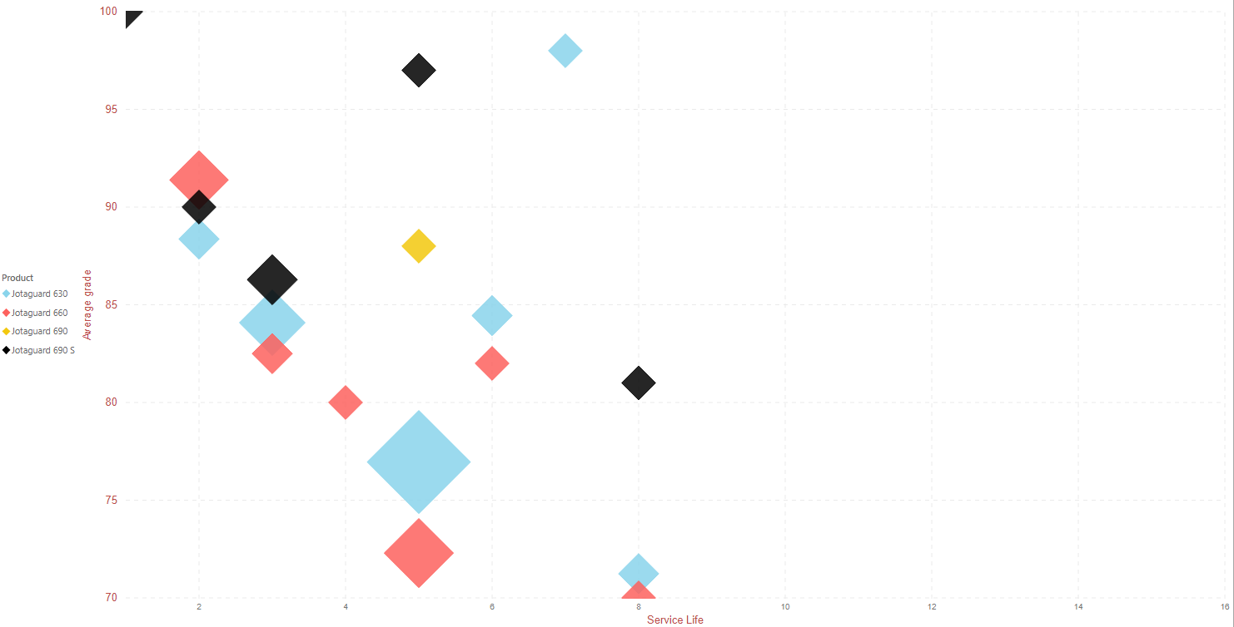
Product Profile(Jotaguard series)
Jotaguard 690S has the best performance during 3-5 service years
630 is better than 660 after 2 years.
690 is seldom used.
Most vessels will be docked in 3-5 years.

Slide 16
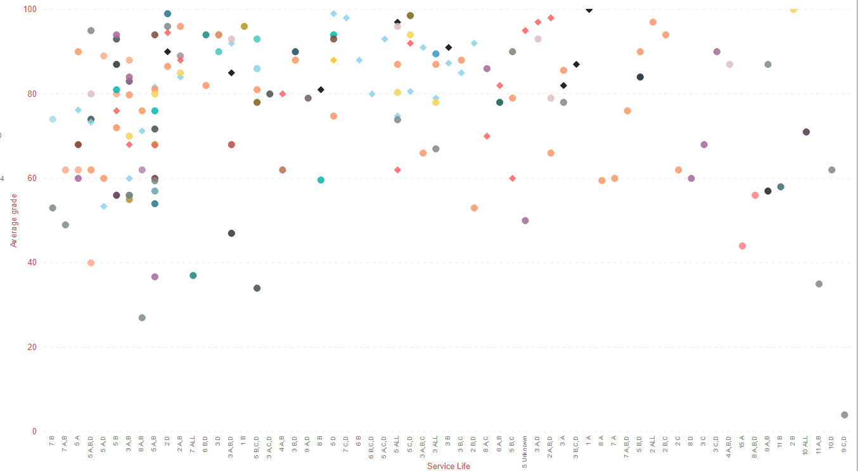
Product Profile(all including competitors)
*Diamond shape represents jotaguard
Compared to other competitors , jotaguard series has better performance in 3-5 years with cargo type A,B,C,D（all cargo types）

Slide 17
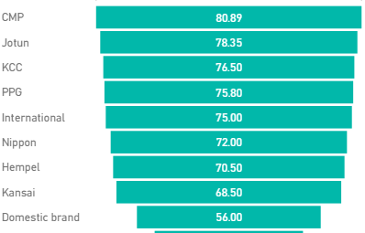
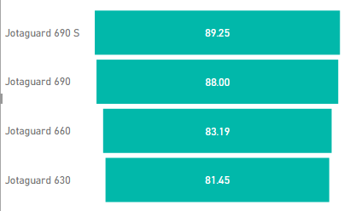
General comparision
Supplier | Product | Main Cargo Type | Average of Performance score
Jotun | Jotaguard 630 | D | 99
Jotun | Jotaguard 660 | D | 99
Jotun | Jotaguard 660 | A,B,D | 98
Jotun | Jotaguard 660 | A,D | 97
Jotun | Jotaguard 690 S | ALL | 97
Jotun | Jotaguard 630 | A,C,D | 93
Jotun | Jotaguard 630 | B,D | 92
Jotun | Jotaguard 660 | C,D | 92
Jotun | Jotaguard 630 | A,B,C | 91
Jotun | Jotaguard 690 S | A | 91
Jotun | Jotaguard 690 S | A,C,D | 91
Jotun | Jotaguard 660 | B,D | 88
Jotun | Jotaguard 690 | D | 88
Jotun | Jotaguard 690 S | B,C,D | 87
Jotun | Jotaguard 630 | C,D | 86.67
Jotun | Jotaguard 630 | B | 86
Jotun | Jotaguard 690 S | B | 86
Jotun | Jotaguard 690 S | A,B,D | 85
Jotun | Jotaguard 630 | A,B | 82.71
Jotun | Jotaguard 630 | A | 81
Jotun | Jotaguard 660 | A,B | 81
Jotun | Jotaguard 630 | B,C,D | 80
CMP has the highest average performance in the ranking.
Jotaguard series is much better than the Jotun average.
Jotaguard 630,660 performed very well with type D.

Slide 18
SWOT Analysis
S
O
S
Good anticorrosive performance with different cargo types especially the jotaguard series.
W
High price
W
Higher application standard
T
O
690s is vey good but less consumed
T
CMP has vey strong performance and lower price

Slide 19
分析结论
0 4
Recommenddations

Slide 20
Recommendations
Suggest the customer to use Jotaguard more especially the jotagurd 690s as it has very good performance in cargo hold. With the performance pictures to be used
Recommend the customer if it carried type D often using jotaguard 630&660 as it has the best performance in the scoring.
Kansai & oldendorff preferred to use jotaguard, we can increase the jotaguard 690s sales.

Slide 21
Thanks
Victor wang
10.2019

